Slide 1
Relational Algebra

Slide 2
Relational Algebra
Relational algebra is a set of operations that enable the user to specify basic retrieval requests. Each operation produces results which is a relation.
Relational algebra expression is a sequence of relational algebra operations whose result will also be a relation.
It provides a formal foundation of relational model
It is used as a basis for implementing and optimizing queries in relational DBMS
Some of its concept incorporated into the SQL for RDBMS

Slide 3
Fundamental Operations
SELECTION / RESTRICTION
PROJECTION
UNION
SET DIFFERENCE
CARTESIAN-PRODUCT
Operations may be of two types depending upon the number of input relations
Unary - Operate on one relation
Binary - Operate on pair of relations

Slide 4
Notion of selection operation
It is denoted by
σ _{<selection condition>}(R)
It is a unary operation that selects a sub set of the tuples from a relation, which satisfies a given predicate.
The SELECT operation can also be visualized as a horizontal partition of the relation into two sets of tuples – one that satisfies the condition & those that do not satisfy the condition.
Predicate appears as a subscript to sigma(σ).
Relational operators can be used in selection predicates for comparisons.
Several predicates can be combined into one predicate using AND (Λ) or OR(V)

Slide 5
Select Operation
It is denoted by: σ _{p}(r)
It is considered as a filter that keeps only those tuples that satisfies a qualifying condition.
p is called the selection predicate (SELECT condition)
Defined as:
σ_{p}(r) = {t | t ∈ r and p(t)}
Where p is a formula in propositional calculus consisting of terms connected by : ∧ (and), ∨ (or), ¬ (not) Each term is one of:
<attribute>op <attribute> or <constant>
where op is one of: =, ≠, >, ≥, <, ≤
Example of selection: σ _{name=“Anil”} (EMPLOYEE)

Slide 6

Selection

Slide 7
--- Select Operation – Example
A
B
C
D
A
B
C
D
α
α
β
β
α
β
β
β
1
5
12
23
7
7
3
10
σ_{A=B ^ D > 5} (r)
α
β
α
β
1
23
7
10
r

Slide 8
Example
Select all loans whose loan amount is greater than repaid amount
σ _{amount > repayments}(loan)

Slide 9
Characteristics of SELECT Operation
The select condition is applied independently to each tuple t in r. If the condition is true, then tuple t is selected and will appear in the resulting relation.
The SELECT operation is unary, it is applied to a single relation.
The degree of resulting relation is the same as r.
The cardinality of resulting relation is less than or equal to r. i.e. | σ _{c}(R)| <= |R|
The SELECT operation is cumulative. A sequence of SELECT operations can be applied in any order.
σ<cond1>(σ<cond2> (r)) = σ<cond2>(σ <cond1>(r))
A cascade of SELECT operations can be combined into a single SELECT operation with a conjunctive (^) condition.
σ<cond1>(…(σ<condn> (r)) = σ<cond1>^<cond2> …<condn>(r)

Slide 10
Example
To select the EMPLOYEE tuples whose department is 4
EMPLOYEE(Eid, Ename, Salary, Dno)
σ _{Dno = 4} (EMPLOYEE)
To select the EMPLOYEE tuples whose salary is greater than 10,000
σ _{Salary > 10000} (EMPLOYEE)
To select the EMPLOYEE tuples whose dapartment is 4 and salary is greater than 10,000
σ _{Dno = 4} (σ _{salary >1000} (EMPLOYEE))
or
σ _{Salary >1000} (σ _{Dno = 4} (EMPLOYEE))
or
σ _{Salary >1000 AND Dno = 4} (EMPLOYEE))

Slide 11
Example
To select the EMPLOYEE tuples who either work in department 4 and make over Rs 15,000 per month or work in department 5 and make over Rs. 10,000 per month
σ (Dno =4 AND salary >=15000) OR (Dno =4 AND salary >=10000) (EMPLOYEE)

Slide 12
Project Operation
Is used to select some attributes from a relation.
Is denoted by:
∏<attribute list>(r)
where <attribute list> are attribute names and r is a relation algebra expression
The result is defined as the relation of <attribute list> columns obtained by erasing the columns that are not listed, and in the same order as they appear in the list.
Example: To eliminate the name attribute of DEPARTMENT
∏_{number} (DEPARTMENT)

Slide 13

Projection

Slide 14
Project Operation – Example
A
B
C
A
C
α
α
β
β
10
20
30
40
1
1
1
2
α
β
β
1
1
2
∏_{A,C} (r)
r
Duplicates Removed

Slide 15
Characteristics of PROJECT Operation
The result of a PROJECT operation will be a relation consisting of the attributes specified in the <attribute list> in the same order.
The degree is equal to the number of attributes in the list.
The projection operations removes any duplicates.
The cardinality of the resulting relation is always less than or equal to the cardinality of r.
For a cascade of PROJECT operations, only the outermost need to be considered for evaluation. If <list1> ⊆ <list2> ⊆ … ⊆ <listn> ⊆ r, then
∏<list1>(∏<list2>(… (∏<listn>(r))) = ∏<list1>(r)

Slide 16
Rename Operation
The rename operation (ρ )(Rho) allows us to name, and therefore to refer to, the results of relational-algebra expressions.
Allows us to refer to a relation by more than one name.
Example:
ρ _{s} (r)
returns the expression r under the name s
If a relational-algebra expression r has arity n, then
ρ_{s} _{(A1, A2, …, An)} (r)
returns the result of expression r under the name s, and with the
attributes renamed to A1, A2, …., An.

Slide 17
Rename Operations: Example
s
A
B
C
α
α
α
a
a
a
α
γ
γ
ρ
(r)
r
A
B
C
s
ρ
(s)
α
α
α
a
a
a
α
γ
γ
(D, E, F )
ρ
(r)
s(D, E, F )
s
D
E
F
α
α
α
a
a
a
α
γ
γ

Slide 18
Rename Example
To retrieve the first name, last name, and salary of all employees who work in department number 5.
The single relational algebra expression as follows
∏ _{Fname,Lname,salary} (σ _{Dno = 5}(EMPLOYEE))
Alternatively we can explicitly show the sequence of operations, giving a name to each intermediate relation
DEP5_EMP σ _{Dno = 5}(EMPLOYEE)
Result(FIRSTNAME , LASTNAME , SALARY) ∏ _{Fname , Lname , salary}(DEP5_EMP)
Rename of Attributes

Slide 19
Union Operation
Is denoted by: r ∪ s
Is defined as:
r ∪ s = {t | t ∈ r or t ∈ s}
The result of r ∪ s will include all tuples which are either in r or in s or in both.
For r ∪ s to be valid r and s must be union compatible
Union compatible – Two relations R(A₁, A₂, ……..,A_{n}) and S(B₁, B₂, ……..B_{n} ) are said to be union compatible if they have the same degree n, and if dom(Ai) = dom(Bi) for 1<= i <= n. This means that the two relations have the same number of attributes and that each pair of corresponding attributes have the same domain.

Slide 20
Union Operation
Union operation is:
Commutative: r ∪ s = s ∪ r
Associative: r ∪ (s ∪ w) = (r ∪ s) ∪ w
E.g. to find all the names of faculty and students in the FACULTY and STUDENT tables:
∏_{name} (FACULTY) ∪ ∏_{name} (STUDENT)

Slide 21
Union Operation – Example
A
B
A
B
A
B
α
α
β
1
2
1
α
β
2
3
α
α
β
β
1
2
1
3
r ∪ s
s
r
No Duplicates

Slide 22
Set Difference Operation
Is denoted by: r – s
Is defined as: r – s = {t | t ∈ r and t ∉ s}
The result of r – s will include all the tuples that are in r but not in s.
r and s must be union compatible
This operation is neither Commutative nor Associative.

Slide 23
Set Difference Operation – Example
A
B
A
B
A
B
α
α
β
1
2
1
α
β
2
3
r – s
α
β
1
1
s
r

Slide 24
Set-Intersection Operation
Is denoted by: r ∩ s
Is defined as: r ∩ s ={ t | t ∈ r and t ∈ s }
The result of r ∩ s will include all the tuples that are in both r and s.
r and s must be union compatible.
Intersection is:
Commutative: r ∩ s = s ∩ r
Associative: r ∩ (s ∩ w) = (r ∩ s) ∩ w
Note: r ∩ s = r - (r - s)

Slide 25
Set-Intersection Operation - Example
A B
A B
A B
r ∩ s
α
α
β
1
2
1
α
β
2
3
α 2
s
r

Slide 26
Cartesian-Product Operation
Is denoted by: r x s, also called cross product
Is defined as:
r x s = {t q | t ∈ r and q ∈ s}
The result of r x s will combine tuples from both r and s in a combinatorial fashion.
Assume that attributes of r(A) and s(B) are disjoint. (That is, A ∩ B = ∅).
If attributes of r(A) and s(B) are not disjoint, then renaming must be used.

Slide 27
Cartesian-Product Operation-Example
A
B
C
D
E
A
B
C
D
E
α
β
1
2
α
β
β
γ
10
10
20
10
a
a
b
b
r x s
α
α
α
α
β
β
β
β
1
1
1
1
2
2
2
2
α
β
β
γ
α
β
β
γ
10
10
20
10
10
10
20
10
a
a
b
b
a
a
b
b
r
s

Slide 28
Example Cartesian Product
Retrieve list of names of each female employee’s dependent.
EMPLOYEE
NAME | SSN | GENDER | SALARY | SUPERSSN
John | 123456789 | M | 30000 | 333445555
Franklin | 333445555 | M | 40000 | 888665555
Alicia | 999887777 | F | 25000 | 987654321
Jennifer | 987654321 | F | 43000 | 888665555
Ramesh | 666884444 | M | 38000 | 333445555
Joyce | 453453453 | F | 25000 | 333445555
Ahmad | 987987987 | M | 25000 | 987654321
James | 888665555 | M | 55000 | Null
DEPENDENT
ESSN | NAME | GENDER | RELATIONSHIP
333445555 | Robort | M | Son
987654321 | Abner | M | Son
123456789 | Alice | F | Daughter

Slide 29
Relational Algebra Solution
FEMALE_EMPS ⬅ σ _{sex=‘F’} (EMPLOYEE)
EMPNAMES⬅ ∏ _{Fname,Lname, Ssn} (FEMALE_EMPS)
EMP_DEPENDENTS ⬅ EMPNAMES x DEPENDENT
Actual_dependents ⬅ σ _{Ssn=Essn} (EMP_DEPENDENTS)
RESULT ⬅ ∏ _{Fname,Lname, Dependent_name} (ACTUAL_DEPENDENTS)

Slide 30
Steps
FEMALE_EMP
NAME | SSN | GENDER | SALARY | SUPERSSN
Alicia | 999887777 | F | 25000 | 987654321
Jennifer | 987654321 | F | 43000 | 888665555
Joyce | 453453453 | F | 25000 | 333445555
EMPNAMES
NAME | SSN
Alicia | 999887777
Jennifer | 987654321
Joyce | 453453453

Slide 31
Steps
EMP_DEPENDENTS
NAME | SSN | ESSN | NAME | GENDER | ….
Alicia | 999887777 | 333445555 | Robort | M | ….
Alicia | 999887777 | 987654321 | Abner | M | ….
Alicia | 999887777 | 123456789 | Alice | F | ….
Jennifer | 987654321 | 333445555 | Robort | M
Jennifer | 987654321 | 987654321 | Abner | M | ….
Jennifer | 987654321 | 123456789 | Alice | F | ….
Joyce | 453453453 | 333445555 | Robort | M | ….
Joyce | 453453453 | 987654321 | Abner | M | ….
Joyce | 453453453 | 123456789 | Alice | F | ….
ACTUAL_DEPENDENTS
NAME | SSN | ESSN | NAME | GENDER | ….
Jennifer | 987654321 | 987654321 | Abner | M | ….
RESULTS
NAME | NAME
Jennifer | Abner

Slide 32
Characteristics of Cartesian-Product Operation
Degree r X s = degree(r) + degree(s)
Cardinality of r X s = cardinality(r) * cardinality(s)
Generally the result of CARTESIAN PRODUCT is meaningless unless is followed by SELECT, and is called JOIN.

Slide 33
JOIN Operation
Join Operation combine related tuples from two relations into a single tuple based on join condition.
Its is denoted by: r <join condition>s

Slide 34
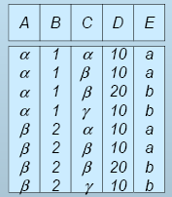
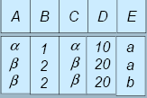
Composition of Operations
Can build expressions using multiple operations
Example: σA=C(r x s)
r x s
σ_{A=C}(r x s)

Slide 35
Characteristic of the Join Operation
Degree of the r s = degree(r) + degree(s).
Cardinality of r s is between 0 and cardinality (r) * cardinality(s).
The order of attributes in r s is { A1, A2, …, An, B1, B2, …, Bm} where A1, A2, …, An attributes of r and B1, B2, …, Bm are attributes of s.
The resulting relation has one tuple for each combination of tuples – one from r and one for s – whenever the combination satisfies the join condition.

Slide 36
Types of Join Operation
Theta join
Equijoin
Natural join
Outer Join
Left Outer Join
Right Outer Join
Full Outer Join

Slide 37
Tables Used in Coming Examples
The following two tables will be used in coming examples.
loan-number
branch-name
amount
loan
L-170
L-230
L-260
Ghaziabad
Meerut
Shaibabad
30000
40000
17000
customer-name
loan-number
borrower
Rajan
Naresh
Seema
L-170
L-230
L-155

Slide 38
Theta Join
Its is denoted by: r <r.A θ s.B> s
Where θ = {=, ≠, < , >, ≤, ≥}
loan _{loan-number = loan-number} Borrower
Loan-number
Branch-name
amount
Customer-name
Loan-number
L-170
Ghaziabad
3000
Rajan
L-170
L-230
Meerut
4000
Naresh
L-230

Slide 39
Equijoin
The most common join involves join conditions with equality comparisons, where θ is {=}. This special type of Theta join is called Equijoin.
Its is denoted by: r <r.A = s.B> s
loan _{loan-number = loan-number} Borrower
Loan-number
Branch-name
amount
Customer-name
Loan-number
L-170
Ghaziabad
3000
Rajan
L-170
L-230
Meerut
4000
Naresh
L-230
The problem with Equijoin is Pairs of attributes with identical values in evey tuple.

Slide 40
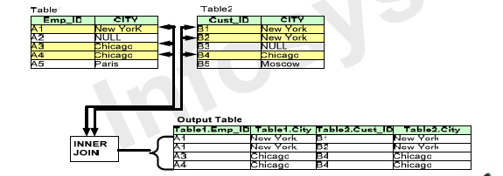
Example of EquiJoin
The Relational Algebra Expression can be written as
Table1 <Table1.City = Table2.city> Table2

Slide 41
Natural-Join Operation
Is denoted by: r * s
Let r and s be relations on schemas R and S respectively. Then, r * s is a relation on schema R ∪ S obtained as follows:
Consider each pair of tuples t_{r} from r and t_{s} from s.
If t_{r} and t_{s} have the same value on each of the attributes in R ∩ S, add a tuple t to the result, where
t has the same value as t_{r} on r
t has the same value as t_{s} on s

Slide 42
Natural-Join Operation
Example:
R = (A, B, C, D)
S = (E, B, D)
Result schema = (A, B, C, D, E)
r * s is defined as: ∏_{r.A, r.B, r.C, r.D, s.E} (σ_{r.B = s.B} ∧ _{r.D = s.D} (r x s))

Slide 43
Natural Join Operation – Example 1
A
B
C
D
B
D
E
A
B
C
D
E
α
β
γ
α
δ
1
2
4
1
2
α
γ
β
γ
β
a
a
b
a
b
1
3
1
2
3
a
a
a
b
b
α
β
γ
δ
∈
r * s
α
α
α
α
δ
1
1
1
1
2
α
α
γ
γ
β
a
a
a
a
b
α
γ
α
γ
δ
r
s
Look for: r.B=s.B ^ r.D = s.D

Slide 44
Natural Join – Example 2
loan * Borrower
loan-number
branch-name
amount
customer-name
L-170
L-230
Ghaziabad
Meerut
3000
4000
Rajan
Naresh
Unlike Equijoin, no pairs of attributes with identical values in evey tuple.

Slide 45
Outer Join
An extension of the join operation that avoids loss of information.
Computes the join and then adds tuples form one relation that does not match tuples in the other relation to the result of the join.
Uses null values:
null signifies that the value is unknown or does not exist

Slide 46
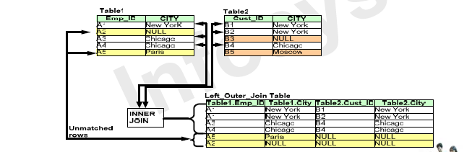
Left Outer Join – Example
Left outer join includes all records from first(left) of two relations
The relational Algebra Expression
Table1 _{<Table1.City = Table2.city>} Table2

Slide 47
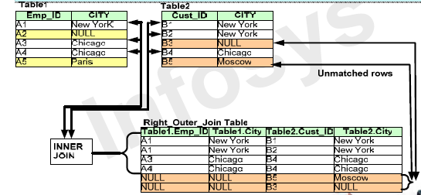
Right Outer Join – Example
Right outer join includes all records from second(Right) of two relations
The relational Algebra Expression
Table1 _{<Table1.City = Table2.city>} Table2

Slide 48
Full Outer Join
It is neither "left" nor "right"— it's both! It includes all the rows from both of the tables or result sets participating in the JOIN. When no matching rows exist for rows on the "left" side of the JOIN, you see Null values from the result set on the "right” and vice versa.
If 2 joined tables contain M and N rows, then cross join will always produce (M x N) rows, but full outer join will produce from MAX(M,N) to (M + N) rows.

Slide 49
OUTER UNION Operation
If the relations are not UNION Compatible.
It operate on Partially Union Compatible relations.
For example R(X, Y) and S(X, Z) Result T(X, Y, Z)
Same combination appears only ONCE in the result
For example STUDENT(Name, SSN, Department, Advisor)
INSTRUCTOR(Name, SSN, Department, Rank)
STUDENT_OR_INSTRUCTOR(Name, SSN, Department, Advisor, Rank)
Student ∗ Professor ∪ Professors that are not students (with null for Advisor) ∪
Students that are not professors (with null for Rank)

Slide 50
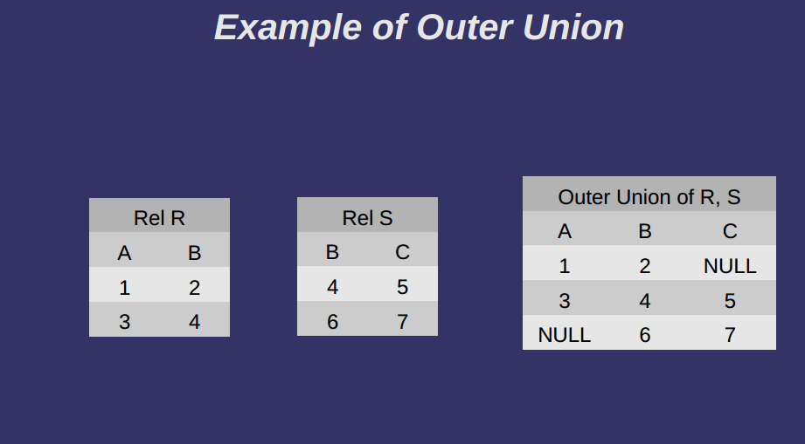

Slide 51
Example
PEOPLE:
Name Age Food
Alice 21 Hamburger
Bill 24 Pizza
Carl 23 Beer
Dina 19 Shrimp
MENU:
Food Day
Pizza Monday
Hamburger Tuesday
Chicken Wednesday
Pasta Thursday
Tacos Friday
PEOPLE U* MENU
Name Age Food Day
Alice 21 Hamburger Tuesday
Bill 24 Pizza Monday
Carl 23 Beer NULL
Dina 19 Shrimp NULL
NULL NULL Chicken Wednesday
NULL NULL Pasta Thursday
NULL NULL Tacos Friday

Slide 52
Division Operation
Is denoted by: r ÷ s
Suited to queries that include the phrase “for all”.
Let r and s be relations on schemas R and S respectively where
R = (A₁, …, A_{m}, B₁, …, B_{n})
S = (B₁, …, B_{n})
The result of r ÷ s is a relation on schema R – S = (A₁, …, A_{m})
r ÷ s = { t | t ∈ ∏ _{R-S}(r) ∧ ∀ u ∈ s ( tu ∈ r ) }

Slide 53
in A/B, the attributes in B must be included in the schema for A. Also, the result has attributes A-B.

Slide 54
Examples of Division A/B
B1
B2
B3
A
A/B1
A/B2
A/B3
Notes:
14

Slide 55
Division Operation – Example1
A
B
B
A
α
α
α
β
γ
δ
δ
δ
∈
∈
β
1
2
3
1
1
1
3
4
6
1
2
1
2
r ÷ s
α
β
s
r

Slide 56
Division Operations: Example 2
A
B
C
D
E
D
E
A
B
C
r ÷ s
α
α
α
β
β
γ
γ
γ
a
a
a
a
a
a
a
a
α
γ
γ
γ
γ
γ
γ
β
a
a
b
a
b
a
b
b
1
1
1
1
3
1
1
1
a
b
1
1
α
γ
a
a
γ
γ
s
r

Slide 57
Division Operation
Property
Let q = r ÷ s
Then q is the largest relation satisfying q x s ⊆ r
Definition in terms of the basic algebra operation Let r(R) and s(S) be relations, and let S ⊆ R
r ÷ s = ∏_{R-S} (r) –∏_{R-S} ( (∏_{R-S} (r) x s) – ∏_{R-S,S}(r))
To see why
∏_{R-S,S}(r) simply reorders attributes of r
∏_{R-S}(∏_{R-S} (r) x s) – ∏_{R-S,S}(r)) gives those tuples t in ∏_{R-S} (r) such that for some tuple u ∈ s, tu ∉ r.

Slide 58
Tables Used in Coming Examples
The following two tables will be used in coming examples.
loan
loan-number
branch-name
amount
L-170
L-230
L-260
Dammam
Meerut
Khobar
30000
40000
17000
borrower
Depositor
customer-name
loan-number
customer-name
Acc-number
Rajan
Naresh
Seema
L-170
L-230
L-155
Raj
Rahul
Seema
Sanjay
S-150
S-250
S-150
S-221

Slide 59
Example Queries
Find all loans of over $1200
σ_{amount > 1200} (loan)
Find the loan number for each loan of an amount greater than $1200
∏_{loan-number} (σ_{amount} _{> 1200} (loan))

Slide 60
Example Queries
Find the names of all customers who have a loan, an account, or both, from the bank
∏_{customer-name} (borrower) ∪ ∏_{customer-name} (depositor)
Find the names of all customers who have a loan and an account at bank
∏_{customer-name} (borrower) ∩ ∏_{customer-name} (depositor)

Slide 61
Example Queries
Find the names of all customers who have a loan at the Meerut branch.
∏_{customer-name} (σ_{branch-name=“Meerut”} (borrower * loan))
Find the of all customers who have a loan at the Meerut branch but do not have an account at any branch of the bank
∏_{customer-name} (σ_{branch-name = “Meerut”} (borrower * loan)) – ∏_{customer-name}(depositor)

Slide 62
Example Queries
Find the names of all customers who have a loan at the Meerut branch.
Query 1 ∏_{customer-name}(σ_{branch-name = “Meerut”} (borrower * loan))

Slide 63
Example Queries
Find the largest account balance. Rename account relation as d
∏_{balance}(account) - ∏_{account.balance}
(σ_{account.balance < d.balance} (account * ρ_{d} (account)))

Slide 64
Example Queries
Find all customers who have an account from at least the “Dammam” and the “Khobar” branches.
Query 1
∏CN(σBN=“Dammam”(depositor * account)) ∩
∏CN(σBN=“Khobar”(depositor * account))
where CN denotes customer-name and BN denotes branch-name.
Query 2
∏customer-name, branch-name (depositor * account) ÷ ρtemp(branch-name) ({(“Dammam”), (“Khobar”)})

Slide 65
Example Queries
Find all customers who have an account at all branches located in Dammam city.
∏customer-name, branch-name (depositor * account) ÷ ∏branch-name (σbranch-city = “Dammam” (branch))

